Slide 1

Fire-Fighter Robot
Presented by:
Rhea Bagul | Manas Gadge | Rohit Rathod | Vimlendu Yadav
Roll No:2 | Roll No:10 | Roll No:41 | Roll No:54
Guided by :
Prof. Dhanshree Jadhav
(Asst. Professor EXTC )
Department of Electronics & Telecommunication Engineering
K. C. College of Engineering & Management Studies & Research
(Affiliated to the University of Mumbai)
Mith Bunder Road, Near Hume Pipe, Kopri, Thane (E)-400603

Slide 2
KCCEMSR, THANE OUTLINE OF PRESENTATION
Sr. No. | Content
1 | Introduction
2 | Literature Survey
3 | Problem Statement
4 | Objective of Study
5 | Components used
6 | Methodology
7 | Application
8 | Conclusion & Future Scope
9 | References

Slide 3
KCCEMSR, THANE
INTRODUCTION
Robots of todays era reduces human efforts.
Fire extinguisher Robot detects and extinguish fire at its own.
Designing a prototype that could autonomously detect the fire and extinguish it.
Robot will automatically work once it detects a fire breakout.
Our prototype will help in rescue operations during fire incident where humans cannot enter.
Robot consist of the three flame sensors.
Sensors are used to detect fire IN all directions and move to fire location.
Robot after reaching the fire area extinguishes the fire using the water pump attached to it.
Fire-Fighter Robot

Slide 4
KCCEMSR, THANE
LITERATURE SURVEY
Title of Journal | Year | Methodology Used | Limitations
Design and Implementation of an IoT Based Firefighting and Affected Area Monitoring Robot | 2021 | The robot's shield is made of calcium silicate boards that can withstand temperatures up to 300 ° C. | This device includes of a calcium silicate board which is quiet expensive .
Development of fire fighting robot(QROB) | 2019 | Ultrasonic sensor to prevent it from colliding with any obstructions or objects nearby. | This device neither extinguish fire nor detect the fire accurately.
Fire Fighting Robot for Disaster Management | 2017 | They use LDR to detect the source of fire light and they use temperature sensor for detecting the temperature. | As this device use LDR for detection of light emitted from fire therefore we cannot say the source of light is always a fire only.
Fire Fighting Robot | 2019 | The presence of flammable gases is detected by a gas sensor. | This device cant be use for household level because the device detect the smoke generated while cooking.
Cease-Fire: the firefighting robot | 2018 | Protect itself from heat using fog sprays. remotely control a wireless communication channel. | Its water/CO2 holding capacity decreases because it also carries fog spray.
Fire-Fighter Robot

Slide 5
KCCEMSR, THANE
PROBLEM STATEMENT
Design and Implementation For Fire-Fighting robot is based on real-time system.
It reduces the time delay in reaching fire affected area & reduce the errors and the limitations that are faced by human fire fighters.
Also Sensors have long life time and less cost.
Fire-Fighter Robot

Slide 6
KCCEMSR, THANE
OBJECTIVE OF STUDY
Using such robots, fire detection and rescue operations can be performed with great security, without putting firefighters at risk.
It has advantageous features such having a compact body and lightweight structure.
The operator is able to extinguish fire accurately in a short period of time.
Fire-Fighter Robot

Slide 7
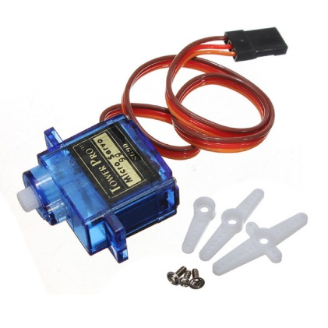
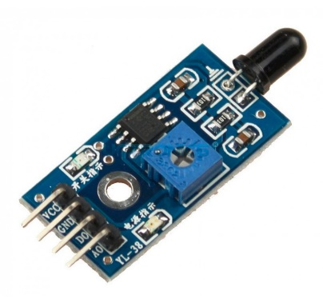
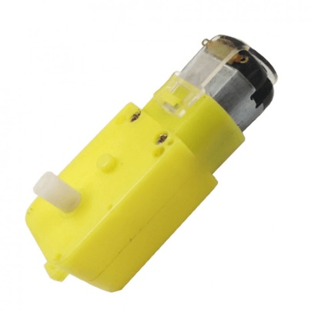
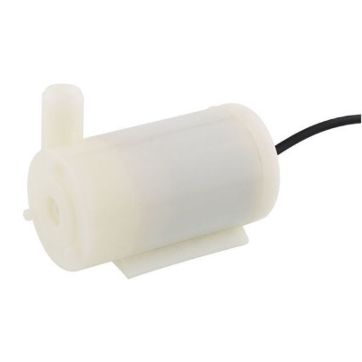
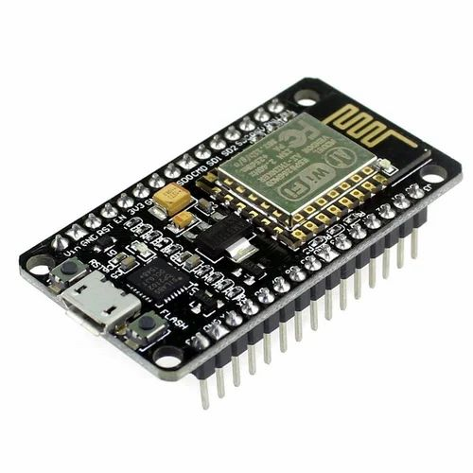
KCCEMSR, THANE
COMPONENTS USED
Flame Sensor
fig(1.1)
Micro Servo Motor
fig(1.2)
Single Shaft Motor
fig(1.3)
Mini Water Pump
fig(1.4)
ESP8266 NodeMCU
fig(1.5)
Fire-Fighter Robot

Slide 8
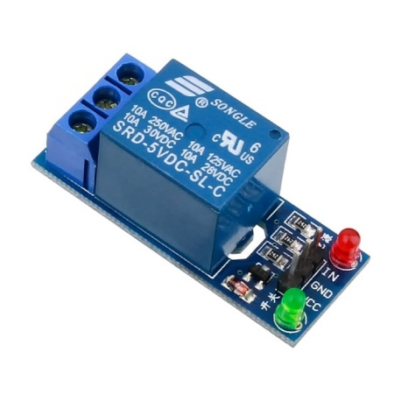
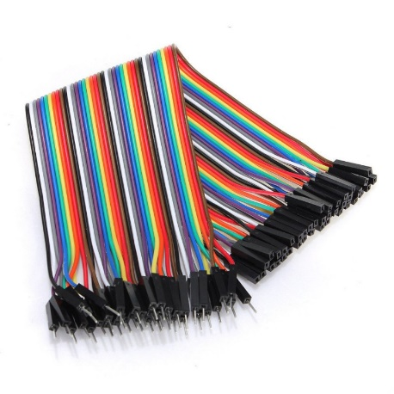
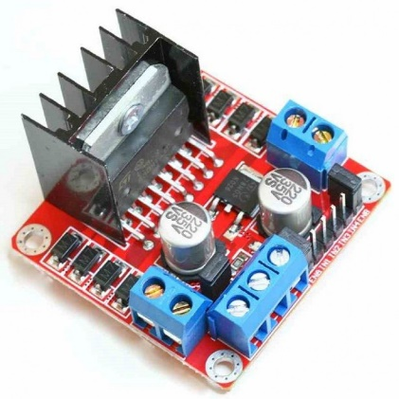
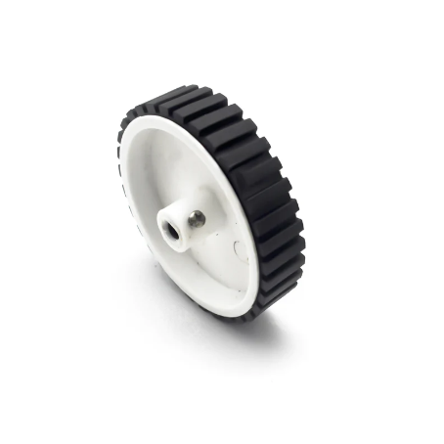
KCCEMSR, THANE
COMPONENTS USED
Relay Module
fig(1.6)
Jumper Wires
fig(1.8)
NodeMcu fig(1.10)
L298N Motor Driver Module
fig(1.7)
Rubber wheel
fig(1.9)
Fire-Fighter Robot

Slide 9
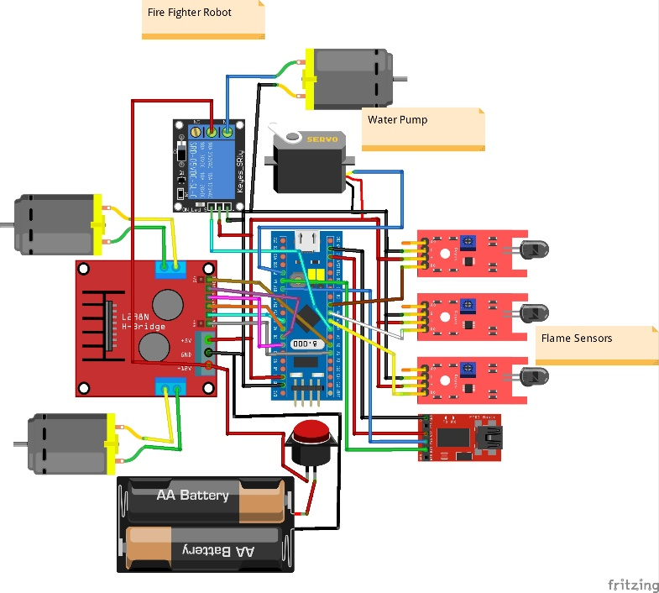
KCCEMSR, THANE
METHODOLOGY
Fig(1.11)Circuit Diagram/Schematic View
Fire-Fighter Robot

Slide 10
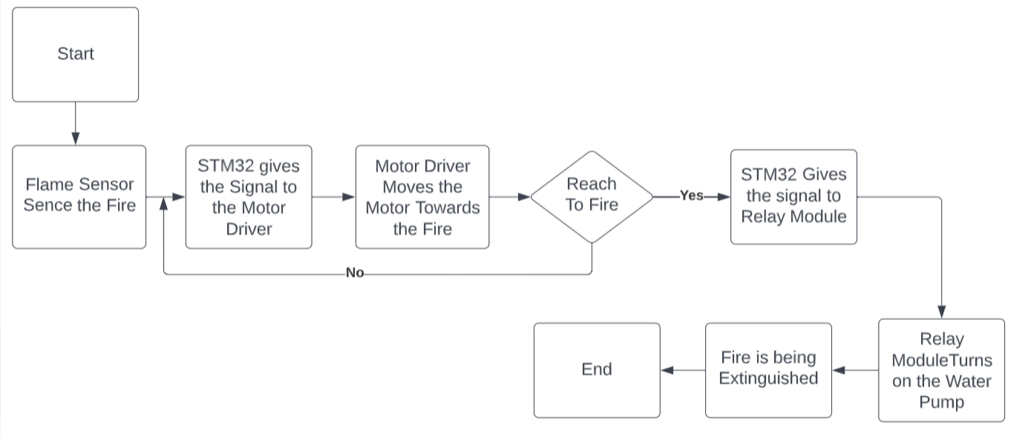
KCCEMSR, THANE
METHODOLOGY
Fire-Fighter Robot

Slide 11
KCCEMSR, THANE
APPLICATION
Become an unmanned support vehicle.
Developed to search and extinguish fire.
Designed to be able to work on its own
Fire identification and rescue activities can be done with higher security .
Placing fire fighters at no high risk and dangerous conditions.
Compact size and automatic control.
It can be used when fire occurs in small and narrow spaces with hazardous.
Fire-Fighter Robot

Slide 12
KCCEMSR, THANE
CONCLUSION
This project describes about the real time firefighting robot which moves in a constant speed, identify the fire and then extinguish it with the help of pumping mechanism . This prototype provides an overview to make
fire-fighting robots smarter, less expensive and more efficient. In further works, the proposed design will be implemented and its performance will be evaluated, in order to ascertain its strength and weakness.
Fire-Fighter Robot

Slide 13
KCCEMSR, THANE
FUTURE SCOPE
We can add the smoke detector in our prototype which gives us the accuracy to detect the fire.
Also we can add the ultrasonic sensor to detect the obstacles between the path.
In addition to this we can develop the body of the robot by using the fire resisting materials For eg: Calcium Silicate Boards.
Fire-Fighter Robot

Slide 14
KCCEMSR, THANE
REFERENCES
[1] Hossain, Md Anowar, Himaddri Shakhar Roy, Md Fazlul Karim Khondakar, Md Hasib Sarowar, and Md Azad Hossainline. "Design and Implementation of an IoT Based Firefighting and Affected Area Monitoring Robot." In 2021 2nd International Conference on Robotics, Electrical and Signal ProcessingTechniques (ICREST), pp. 552-556. IEEE,2021.
[2] Pramod, B.N., K.N.Hemalatha, B. J. Poornima, andR.Harshitha. "Fire Fighting Robot." In 2019 International Conference on Information and Communication Technology Convergence (ICTC), pp. 889-892. IEEE, 2019.
[3] Aliff, Mohd, M. Yusof, Nor Samsiah Sani, and Azavitra Zainal. "Development offirefighting robot(QROB)."Development 10, no. 1 (2019).
[4] Mittal, Shiva, Manish Kumar Rana, Mayank Bhardwaj, Meenakshi Mataray, and Shubham Mittal. "CeaseFire: the firefighting robot." In 2018 International Conference on Advances in Computing, Communication ControlandNetworking(ICACCCN), pp. 1143-1146. IEEE, 2018.
Fire-Fighter Robot

Slide 15
KCCEMSR, THANE
REFERENCES(Contd..,)
[5] Raj, P. Anantha, and M. Srivani. "Internet of Robotic Things based autonomous fire-fighting mobile robot." In 2018 IEEE International Conference on Computational Intelligence and Computing Research (ICCIC), pp. 1-4. IEEE, 2018.
Fire-Fighter Robot

Slide 16
KCCEMSR, THANE
Thank You!!
Any Questions??
Fire-Fighter Robot

